Slide 1
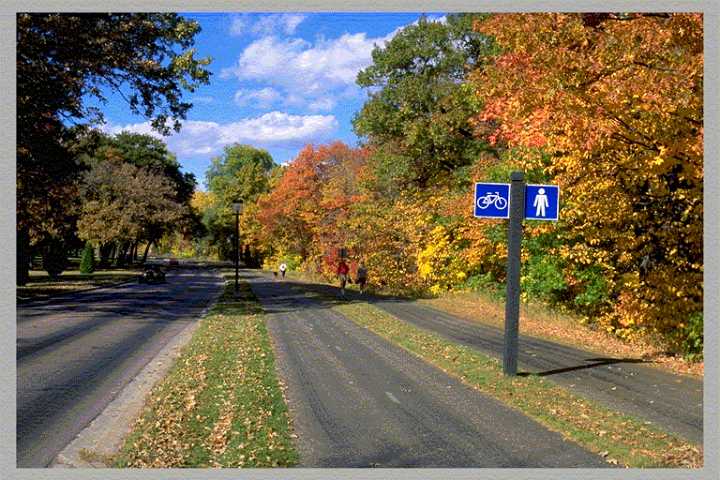
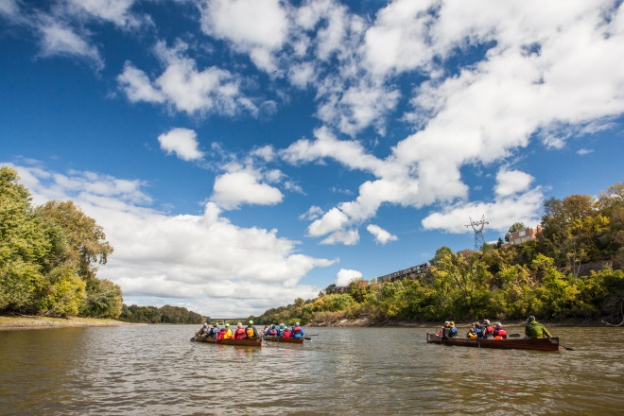
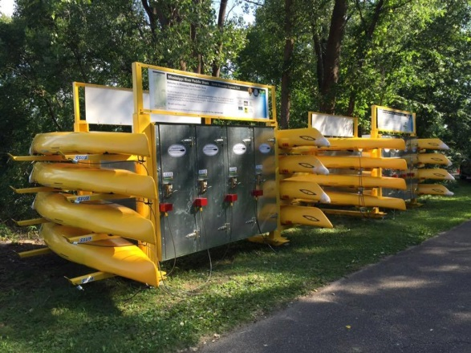
Protecting Visual Resources to Enhance Open Space in a (multi-jurisdictional) Urban River Corridor.
Susan Overson, National Park Service
Mississippi National River and Recreation Area
Upper Mississippi River Conservation Committee
March 23, 2017

Slide 2
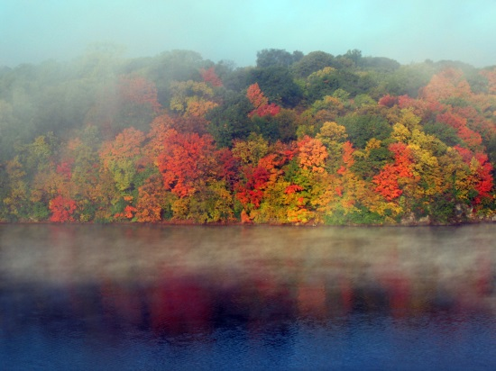
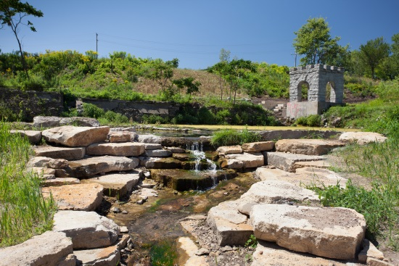
MISSISSIPPI NRRA
54,000-acre urban, national park established by Congress in 1988 to preserve, enhance, and protect the Mississippi River in the Twin Cities metro area
Encompasses 72 miles along both sides of river
NPS owns very little land
Work in partnership with over 25 local governments and 90 river management entities
To preserve and enhance the scenic, recreational, historical, cultural, natural, and scientific values

Slide 3
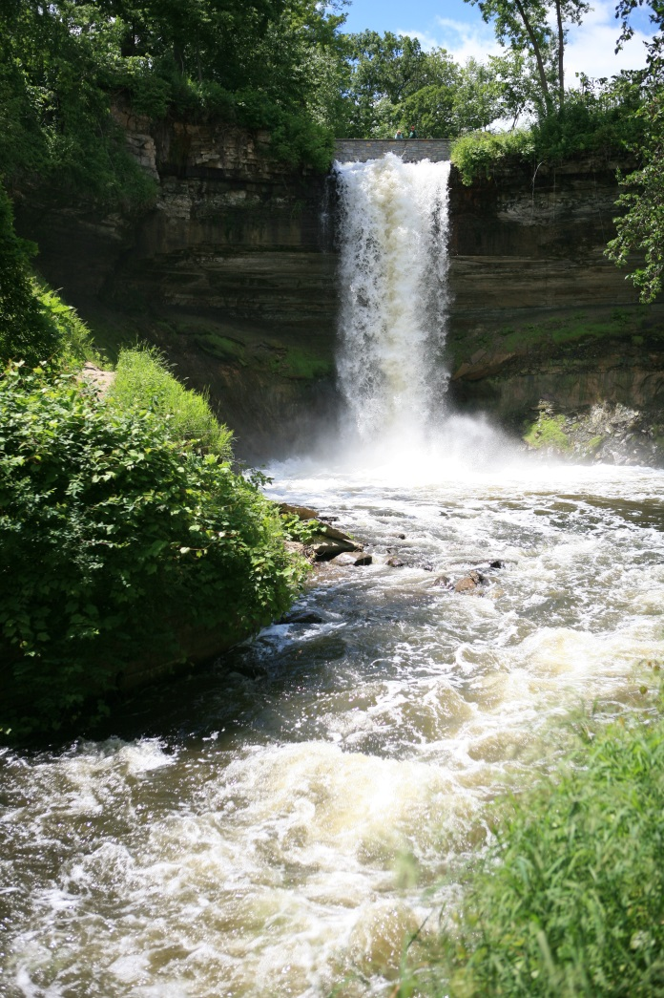
Existing Public Access to Scenic Resources
The Great River Road National Scenic Byway
The Mississippi River National Millennium Trail (MRT)
The Grand Rounds National Scenic Byway
Mississippi NRRA National Water Trail
State, regional, and local parks

Slide 4
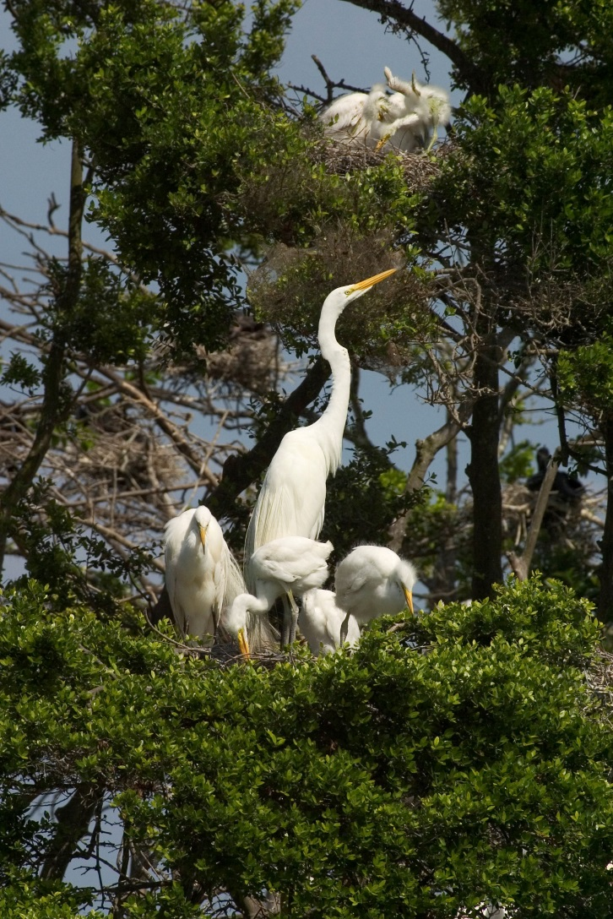
National Park Mandate
"....to conserve the scenery and the natural and historic objects and the wildlife therein and to provide for the enjoyment of the same in such manner and by such means as will leave them unimpaired for the enjoyment of future generations."
NPS Organic Act, 1916

Slide 5
No specific strategy for achieving mandate
Established the Trails and Open Space Partnership to collaborate with over 50 agencies and organizations to create a continuous trail and open space corridor along both sides of the river, while protecting the areas nationally significant resources. (1996)
Worked with local governments to update their river corridor protection plans, as required by the state Executive Order (79-19)
Created an open space protection opportunities map (Identified the ecological value of undeveloped land) (2007)
Worked with Minnesota DNR update the Mississippi River Critical Area rules (2015)
Provided grants to local governments to help achieve goals for protecting the river
No legal mechanism for protecting scenic resources in an urban park.
Only precedents we knew of were from the Blue Ridge Parkway (scenic driving experience through rural, mountainous areas)

Slide 6
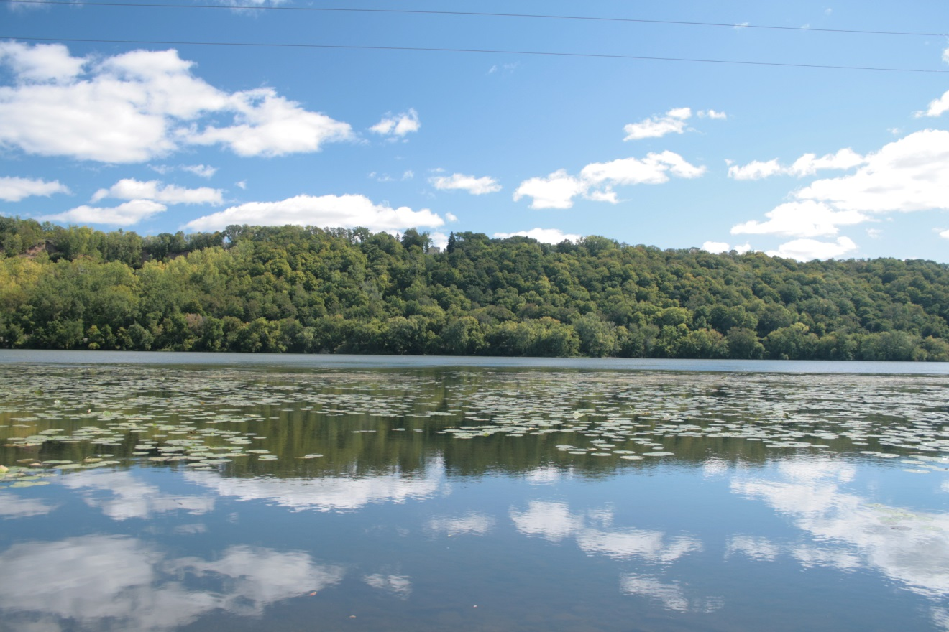
Visual Resource Protection Plan (2014)

Slide 7
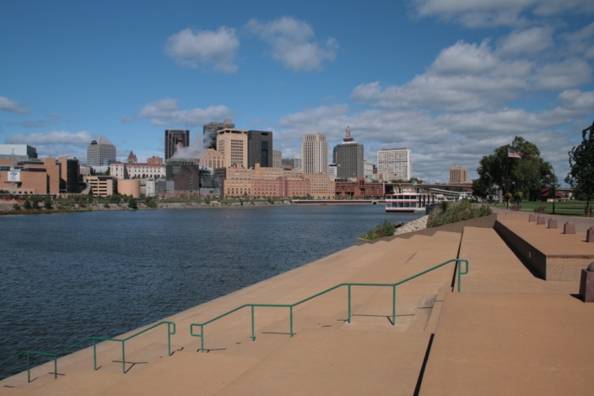
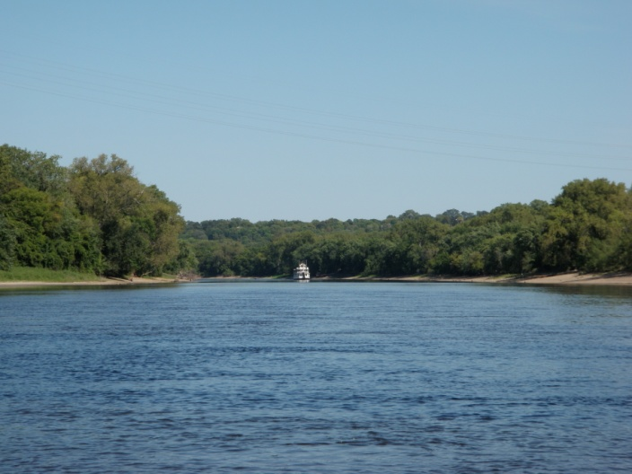
Visual Resource Protection Plan
Scenic views are some of the most highly valued resources
  Threatened by increasing pressures from land uses associated with urban development
  Important for the recreational experience
Partnered with the Mississippi River Parkway Commission
  To develop a plan to preserve, protect, and enhance views along the Mississippi River and Great River Road Scenic Byway
  Funding through the Minnesota Scenic Byway program with match from NPS.

Slide 8
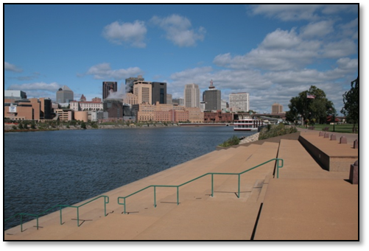
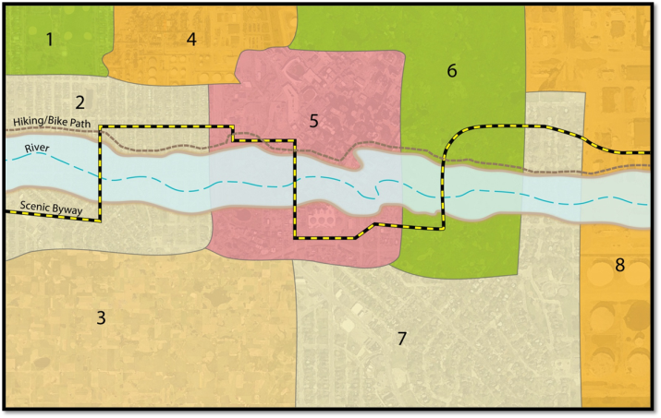
Project Goals
Develop a methodology to identify and evaluate high-quality viewpoints and scenic resources
Provide data that can be useful and informative
Identify opportunities to enhance and protect views
Engage stakeholders in the assessment process
Implementation strategy
Notes:
Keep general – don’t need to get into all of the objectives

Slide 9
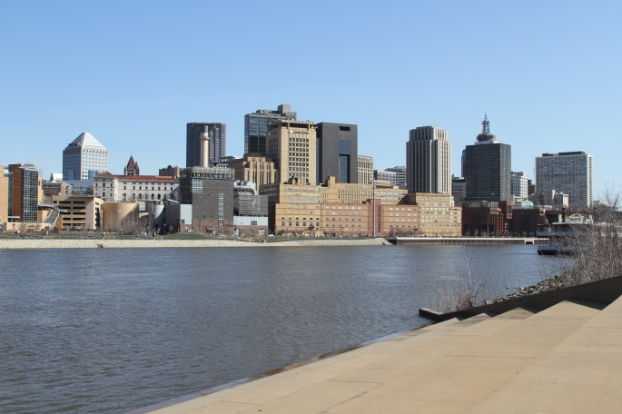
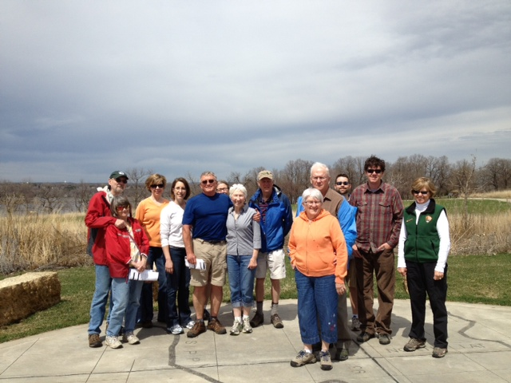
Specific Outcomes
Provide a baseline inventory of important views
Identify threats and opportunities for 50 views
Provide a means for evaluating views
Develop a public participation plan for the evaluation process
Identify improvements for top 20 views
Enhance the overall recreation experience

Slide 10
Methodology
Needed to apply to a broad range of views to work in multiple settings, such as rural or urban
Used four different layers of data merged together to create an overall value:
  Visual Character Unit (VCU)
  Viewpoint Evaluation (VPE)
  Use Intensity & Duration (UID)
  Stability Risk Factor (SRF)
Layers can be updated over time as land uses change or more information becomes available
Notes:
Reviewed other systems first – rural vs. urban

Slide 11
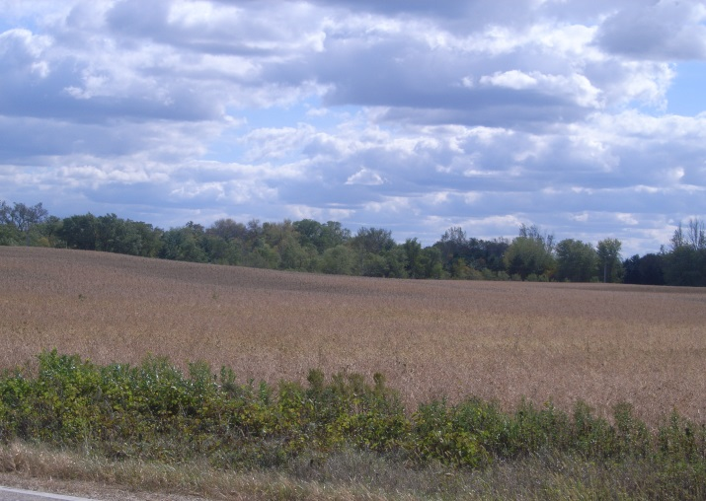
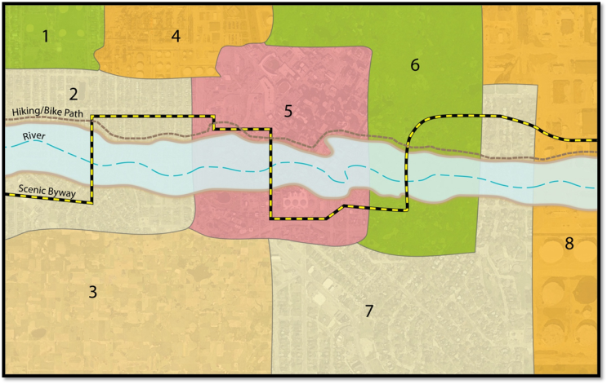
Visual Character Unit (VCU)
A VCU is an area of land with similar visual characteristics and land use patterns
For each VCU, a description and numeric value is given for landform, vegetation, water, and the built environment
Baseline of visual characteristics
Used National Land Cover Database (NLCD)
  Has nationwide coverage
  Supports a wide variety of Federal, State, local and nongovernmental applications
  The data products are available for download at no charge to the public (www.mrlc.gov)
Field documentation

Slide 12
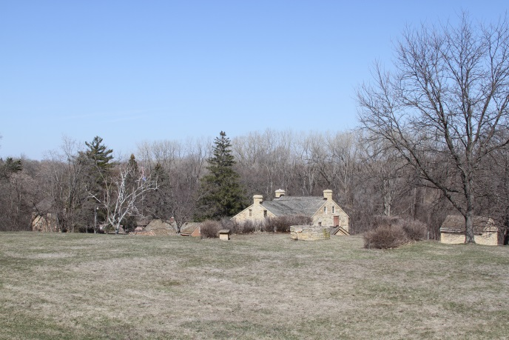
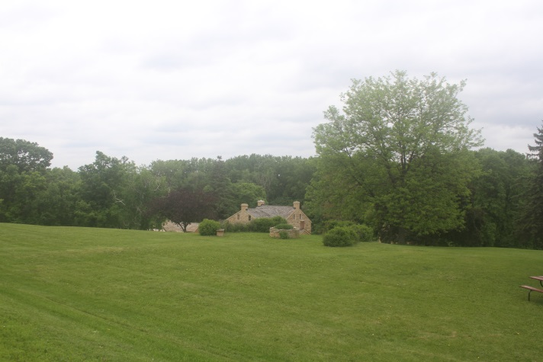
Viewpoint Evaluation (VPE)
Specific locations of high visual interest.
Evaluated during “leaf off” and “leaf on”
Each viewpoint was given a score (1 – 5) for each of the following elements:
  Cohesiveness
  Intactness
  Variety/complexity
  Pattern
  Visual interest
  Uniqueness
This rating was applied to the entire viewshed

Slide 13
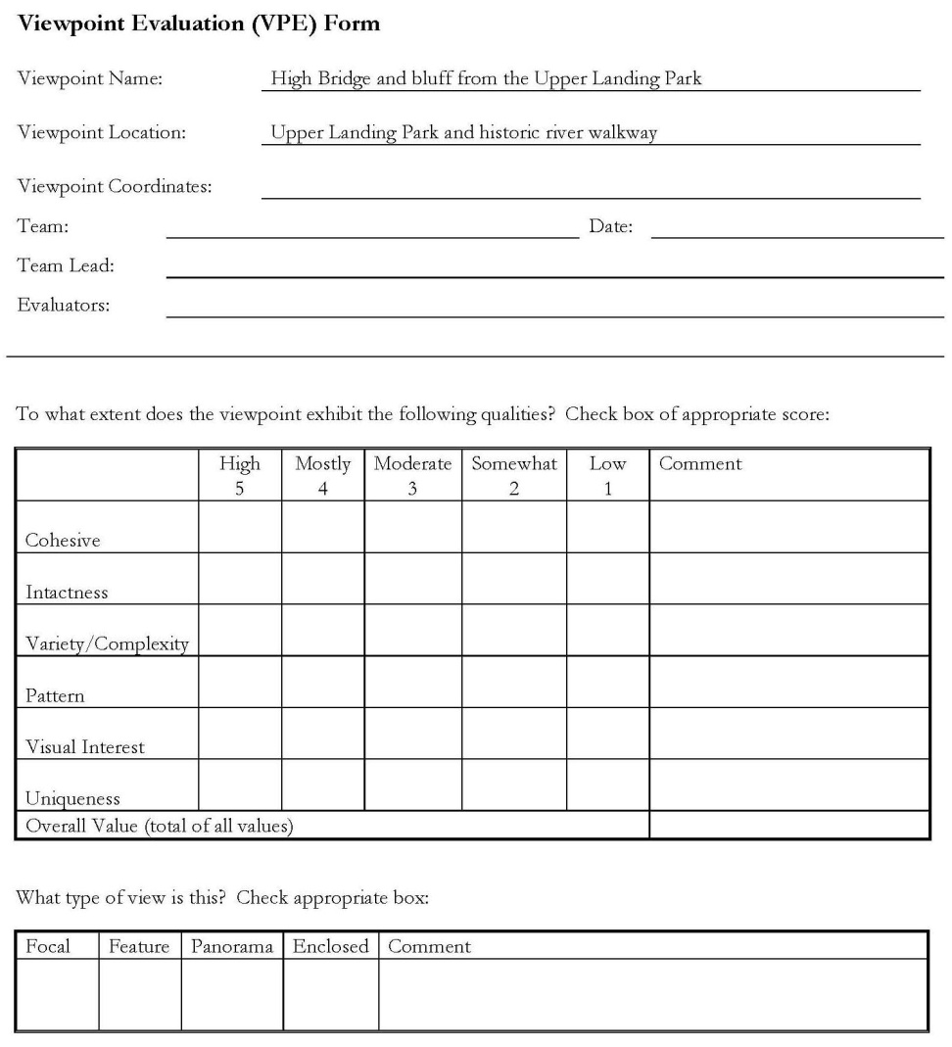
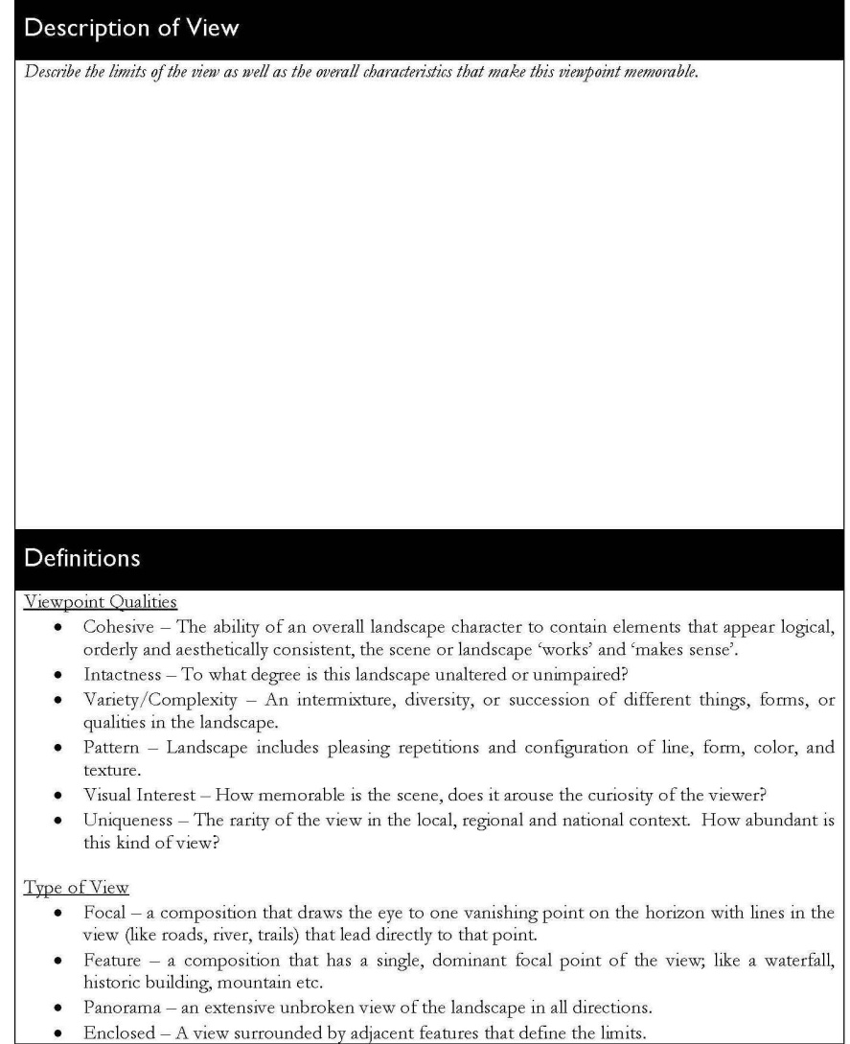
Viewpoint Evaluation (VPE)

Slide 14
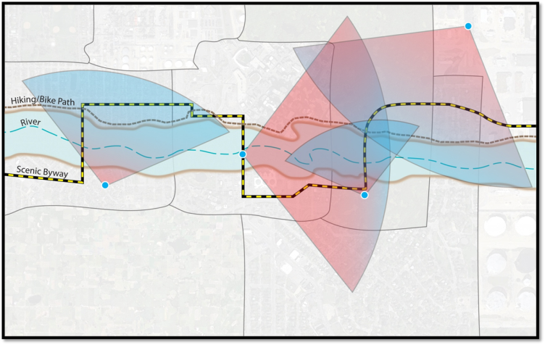
Use Intensity & Duration (UID)
Not all views are experienced in the same way or for the same amount of time
The UID ratio measures the intensity or volume of a type of use, versus the duration of a user experience.
  Car commuters vs. people picnicking at a park
  Both experiences have merit
The ratio is captured from the same viewpoint as the VPE
Values were kept general
  Use ranges from low (1) to high (5)
  Duration ranges from brief (1) to extended (5)

Slide 15
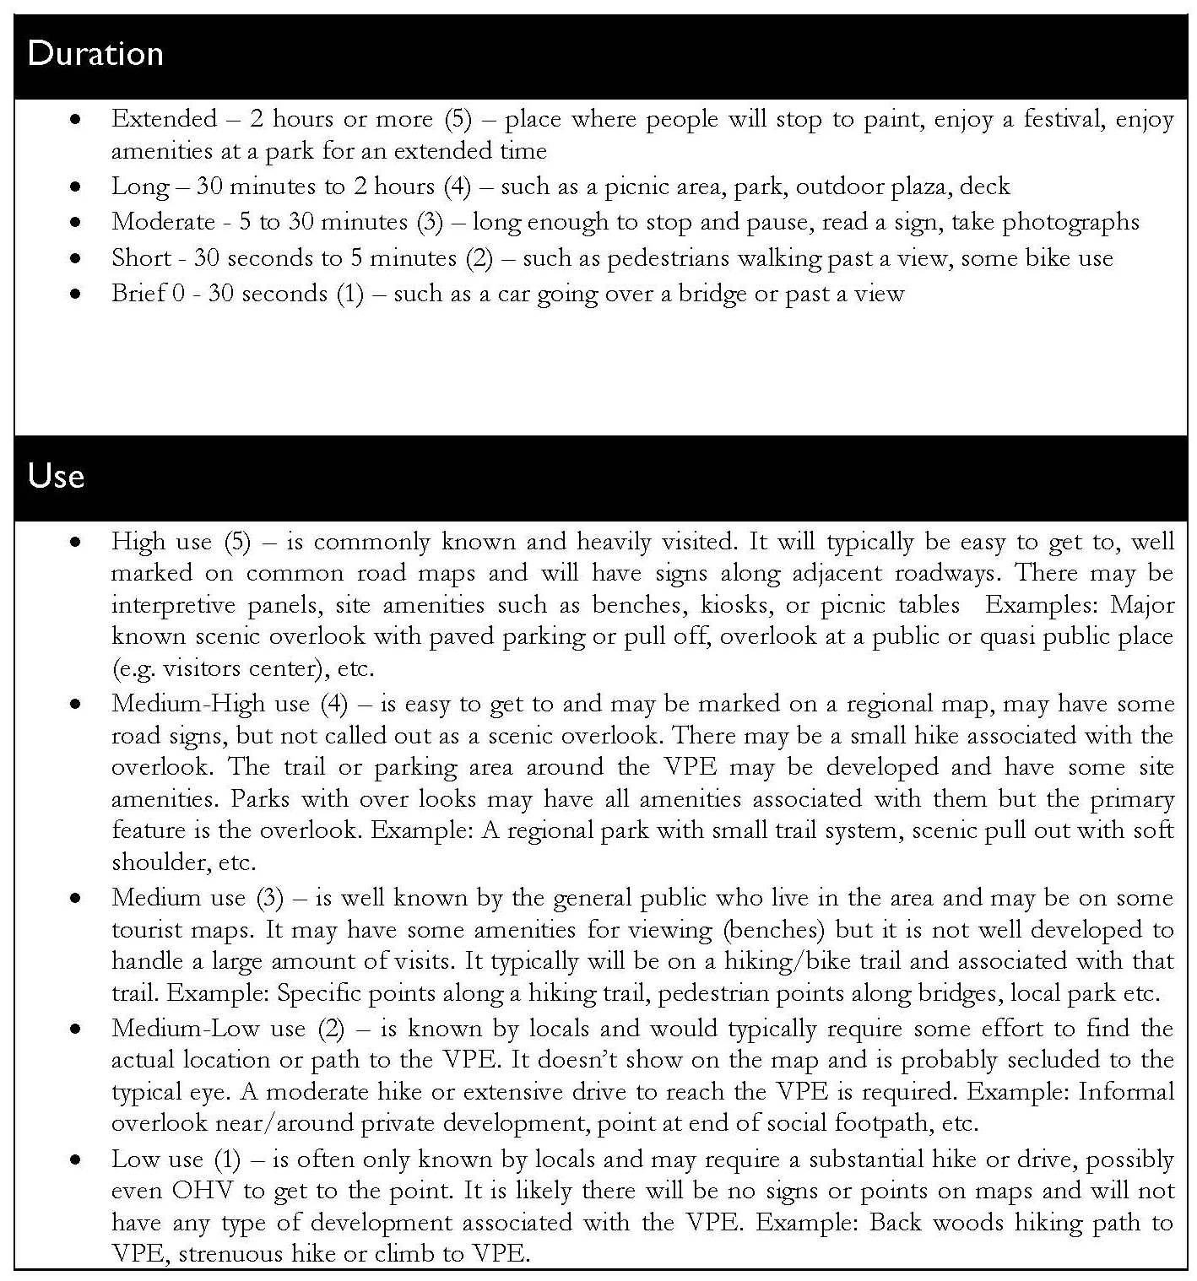
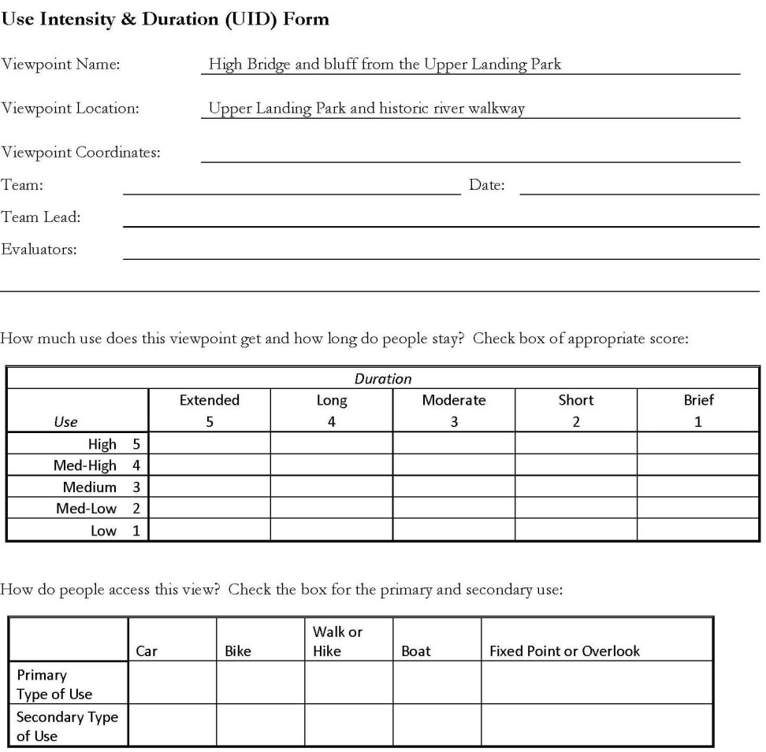
Use Intensity & Duration (UID)

Slide 16
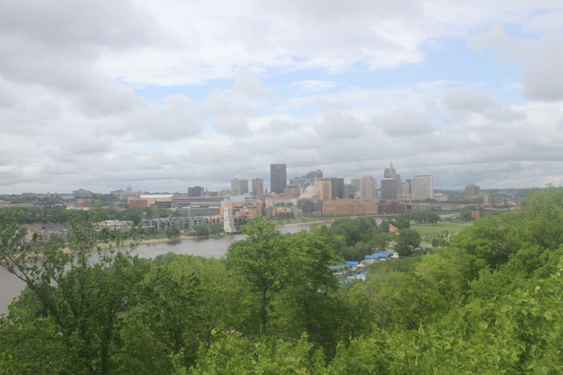
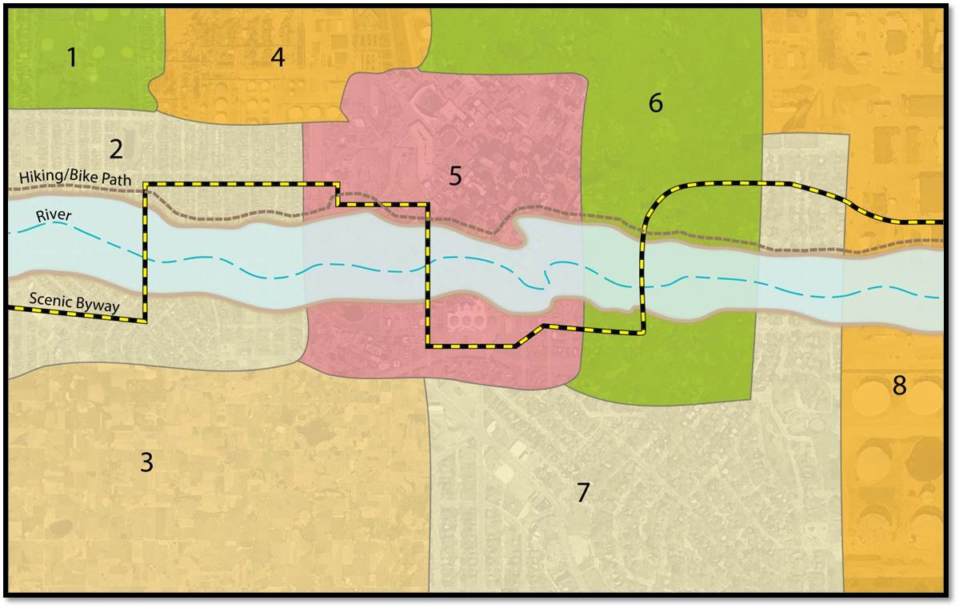
Stability Risk Factor (SRF)
Identified landscapes that are at a higher risk of change than others
Based on the same boundaries that create the VCUs
Low, Medium, High risk
  Low Risk: existing land use that is supported by zoning, such as downtown Minneapolis
  High Risk: agricultural land use, but underlying zoning is residential

Slide 17
Public and Volunteer Involvement
Provided input on which viewpoints to analyze
  Web page, meetings, stakeholders, newsletters, visitor center, email
60 volunteers
  “Leaf Off” April 26, 27, 30
  “Leaf On” June 1, 3, 4
Added credibility to process
Notes:
Have sign up form for next round?

Slide 18
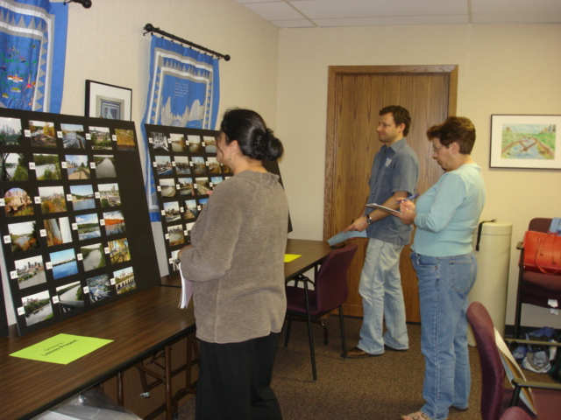
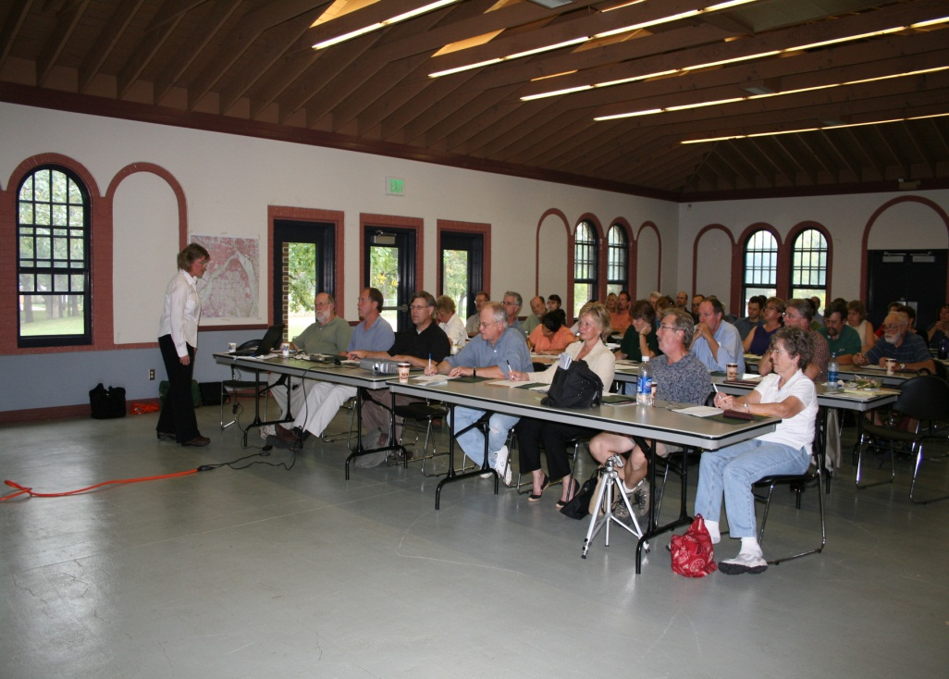
Volunteers/Public Stakeholders received training on how to rank views

Slide 19
Viewpoint Ratings (Leaf Off/On)

Slide 20
Outcomes
Potential for Change

Slide 21
Viewpoint Evaluations
Combined Scores

Slide 22

Management Recommendations for 20 Views

Slide 23
Recommendations/Next Steps
General Management Strategies
  Existing/Potential/Desired Future Conditions
  Five Landscape Categories (Prairie River, Urban River, Gorge, Working River, Forested Floodplain)
  Great River Road Scenic Byway
  20 Specific Views
Managing GIS data
Specific Mitigation/Land Use Strategies
  Zoning Codes
  Design Guidelines
  Vegetation Management
  Maintenance/Enhancement Strategies
  Integrating recommendations into local land use plans and ordinances
Work with local governments to incorporate plan’s recommendations into local land use plans and to apply assessment process to threatened views
Inform other national parks through the NPS Director’s “Enjoy the View” Call to Action Goal, which is building on what we did at Mississippi NRRA
Questions (before I go onto something completely different)?

Slide 24

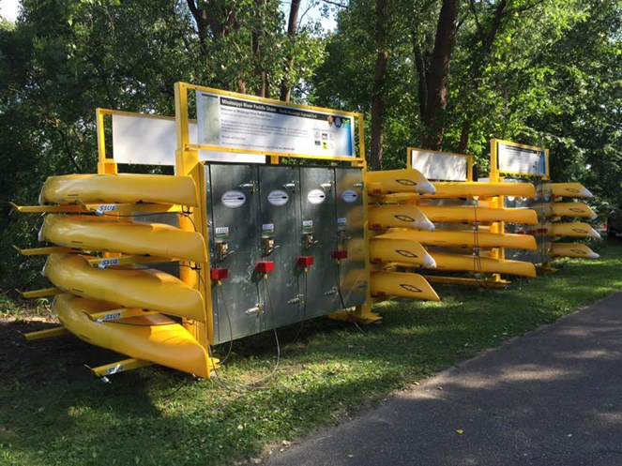
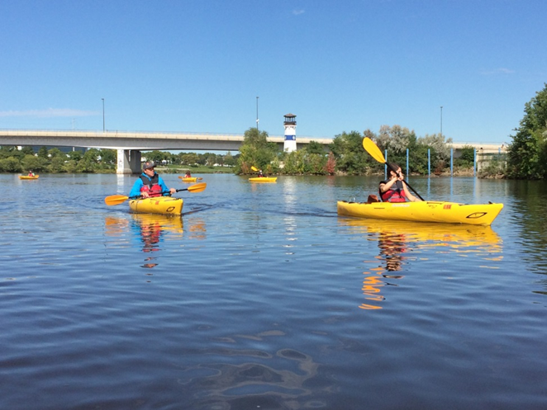
Mississippi River Paddle Share
Launched August 25, 2016
www.paddleshare.org

Slide 25
2016 Pilot Project
First-of-a-kind paddle/bike share in a national park
Self-serve kayak share system similar to Mpls bike share (Nice Ride MN)
Funding - $175,000 NPS/$40,000 REI
6 routes ranked according to specific selection criteria:
  Bike share station
  2 or more transportation facilities (bike, bus, train)
  Popular nearby destinations
  Near major population center
  Safe bike/paddle route
  Willing partner
3.9 mile stretch in Minneapolis scored best (North Mississippi Regional Park to Boom Island)
Installed four paddle share stations:
  North Mississippi Regional Park
  Mississippi Watershed Management Organization
  Boom Island
  Bohemian Flats
Operating Season : August 28 -October 31, 2016 (300 rentals)

Slide 26
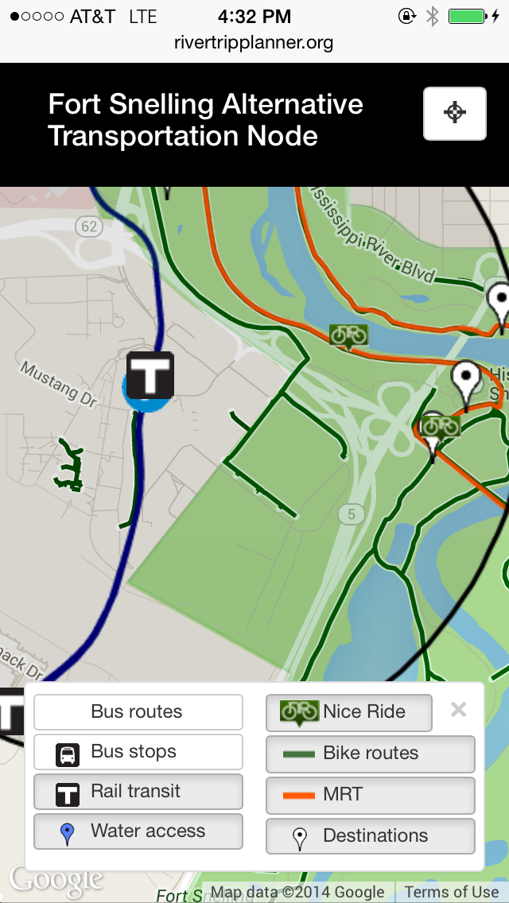
NPS/USDOT Volpe Transportation Center
Oversees equipment purchase, delivery, and installation (iPaddlePort)
Funding/agreements/budget
Compliance with NPS funding criteria
Ensure safety information reaches partners/users
Coordination with Nice Ride Minnesota
Marketing, social media (Facebook and twitter), websites consistent with NPS standards and to improve reservations
  www.paddleshare.org (reservations)
  www.rivertripplanner.org (trip planning)

Slide 27
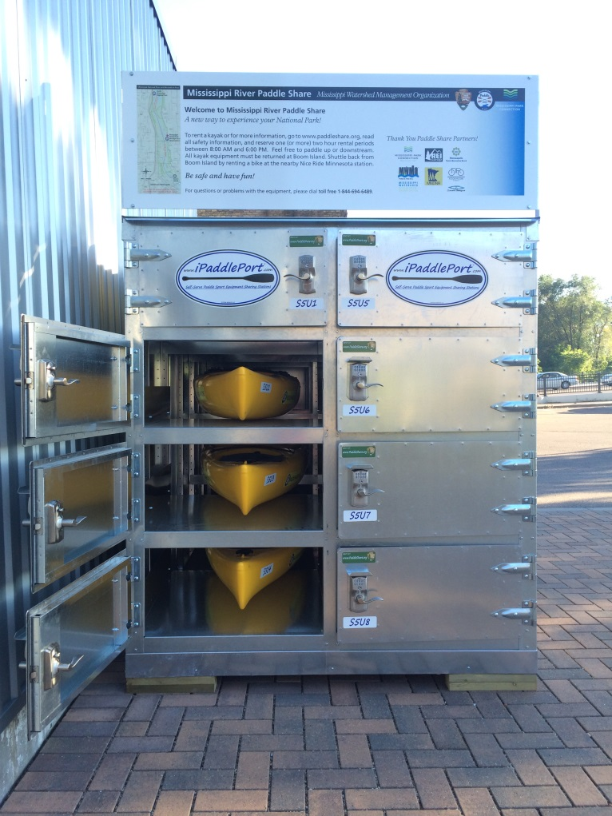
Partner Roles and Responsibilities
NPS/Volpe – Overall Coordination, funding, project management
Landowners – Own, operate, and carry liability insurance
Mississippi Park Connection – Non-profit partner oversees Minneapolis project, fundraising, marketing
iPaddleport – Manufacture, install, reservation system
REI – Private partner funding
WheelFun Rentals – Operations and Maintenance

Slide 28

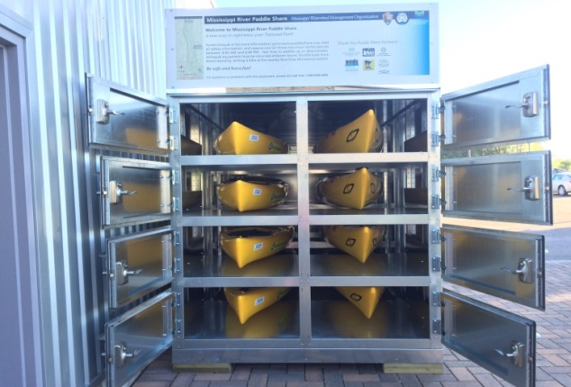
Sustainable Operations Model
Ensure revenue equals/exceeds O&M costs
Partners own stations and do operations and maintenance
Partners carry liability insurance
Site work/installation (Partners)
Public (NPS) and private funding (NPS and MPC)
Robust and coordinated marketing strategy (2017)

Slide 29
2017 Project Budget
Coon Rapids-North Miss
Total capital costs: $118,591
Total O&M estimate: $18,271
Revenue estimate: $19,608
North Miss-Boom Island
Total capital costs: $19,589
Total O&M estimate: $20,804
Revenue estimate: $19,608
Bohemian Flats-Rowing Club
Total capital costs: $28,912
Total O&M estimate: $2,172
Revenue estimate: $13,072
Hidden Falls-Harriet Island
Total capital costs: $69,090
Total O&M estimate: $18,271
Revenue estimate: $13,072
Assumptions
Five months in operation = 89 days
Three 3-hour rental blocks/day
Revenue = $18/rental (cost is $25/rental)
Rental rate = 17% (based on last year)

Slide 30
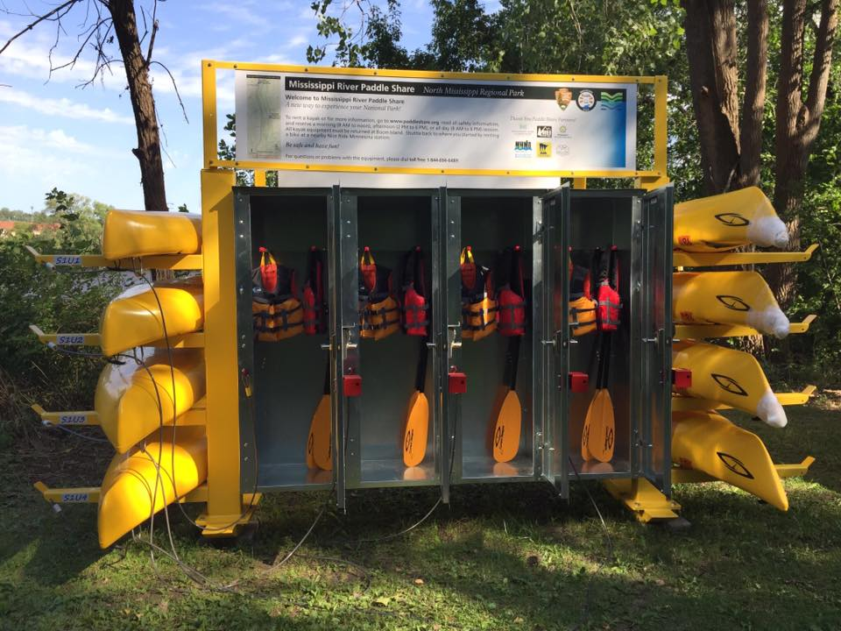
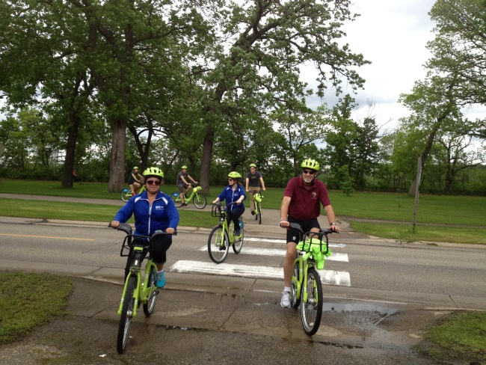
How It Works
Go to www.paddleshare.org
Click “Make a Reservation” at your preferred launch site
Choose a rental period for a single or tandem kayak
Read safety info/sign waiver
Pay with a credit card
Receive access code via email or text that unlocks a specific locker
Remove your equipment, lock locker. Enjoy your paddle!
Return equipment to return station
Take a Nice Ride Minnesota bike back to your launch.

Slide 31
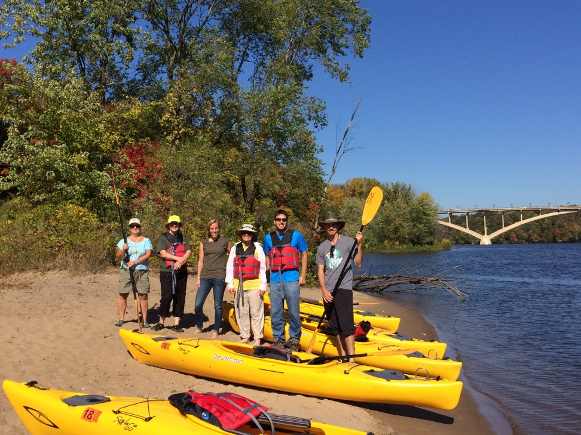
2017 Proposed Expansion
Minneapolis
Add return station at Minneapolis Rowing Club
Saint Paul:
Hidden Falls Regional Park (Rental)
Harriet Island (Return)
Three Rivers Park District:
Coon Rapids Dam Reg Park (Rental)
Brooklyn Park (Rental & Return)
North Miss Regional Park (Return)

Slide 32
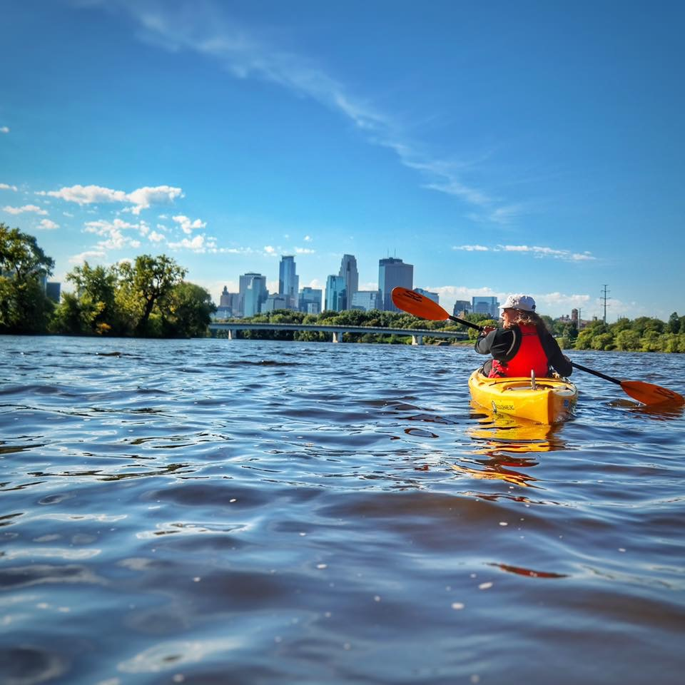
Next Steps
Funding approved (March/April 2017)
Develop agreements (April 2017)
Order equipment (April 2017)
Site work/installation (May 15-June 1, 2017)
Update website, rivertripplanner.org
Plan season opener /event (June 2017)
Revise safety and operations plan
Learn to paddle classes
Open June 1!

Slide 33
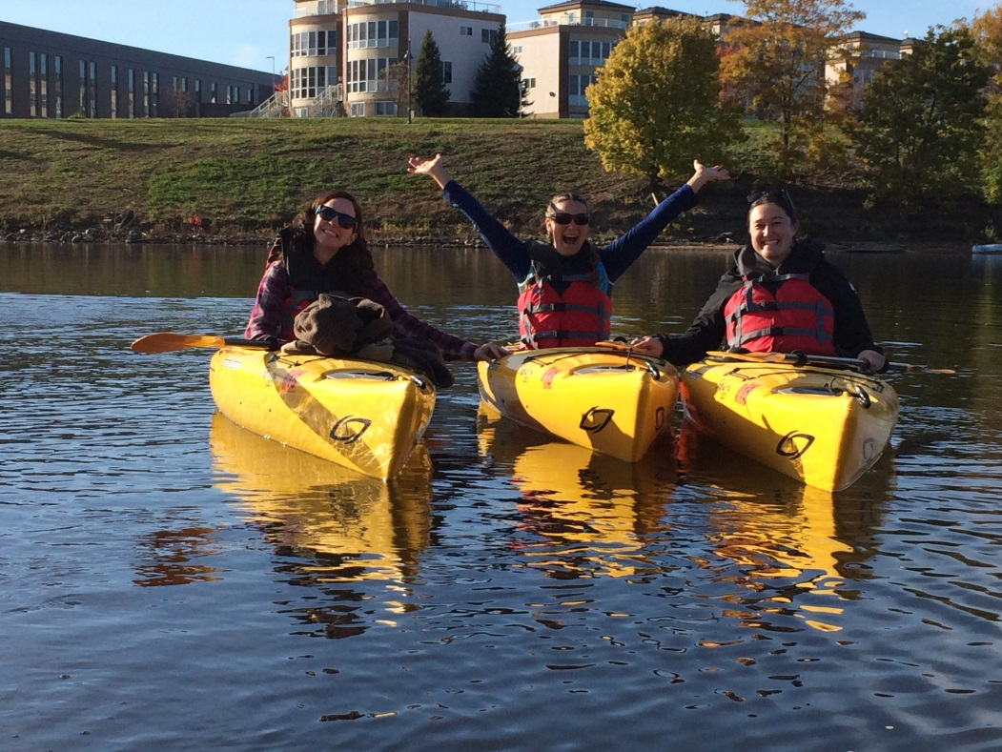
Thank you!
Contact Information:
Susan Overson
Landscape Architect/Park Planner
National Park Service
Mississippi NRRA
d: 651-293-8436
susan_overson@nps.gov

